Slide 1
open a restaurant of Venezuelan food in Toronto, there is customer base?
Tulio Quijada - Coursera - Capstone Project

Slide 2
Introduction/Business Problem section
a friend who recently moved to Toronto, has decided to open a restaurant of Venezuelan food in Toronto.
The most important questions you have are:
Is there a relevant Hispanic community in Toronto with an appetite for this type of flavors?
What would be the most effective neighborhood to open the restaurant, considering the flow of people and close to places of relevance?

Slide 3
Data section
Foursquera / Exploration data / Taking as Center (43.653963 -79.387207) Lat and Log Toronto
path = 'Hispanic countries in latin amertica.csv' / Hispanic countries
path = 'IRCC_PRadmiss_0004_E.xls' / Canada inmigration data
path = 'Toronto recent inmigration.xls'/ inmigrant census for Toronto
'https://en.wikipedia.org/wiki/List_of_postal_codes_of_Canada:_M' / Neighbourhood information Toronto / Lat and Lon

Slide 4
Study Assumption
All hispanic community have a similar taste
location clusters will generate people traffic, independently of the type of venue

Slide 5
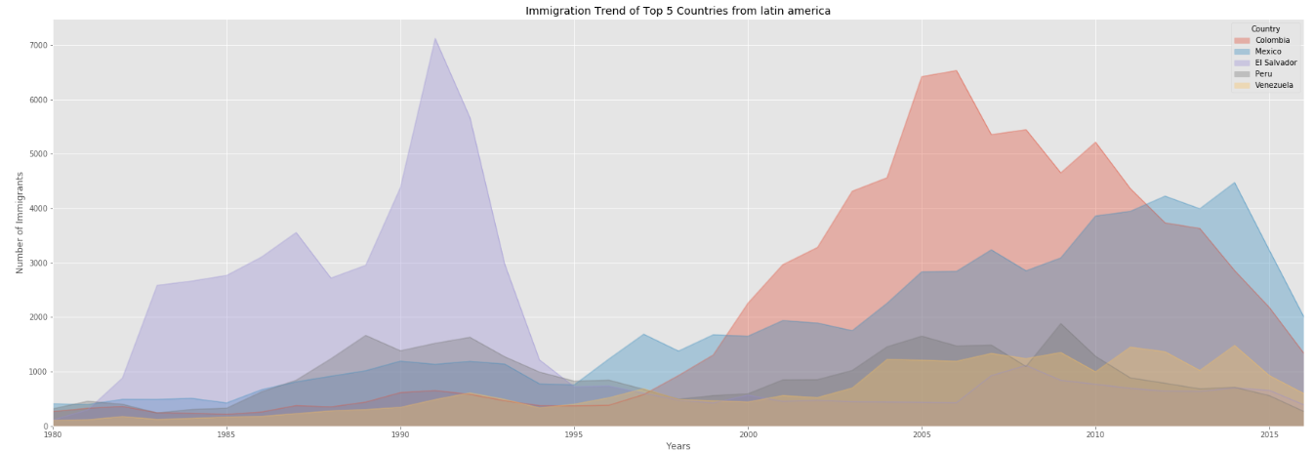
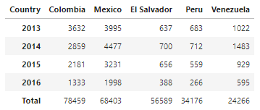
Immigration Trend of Top 5 Countries from latin America to Canada
There is a important Hispanic community in Canada.

Slide 6
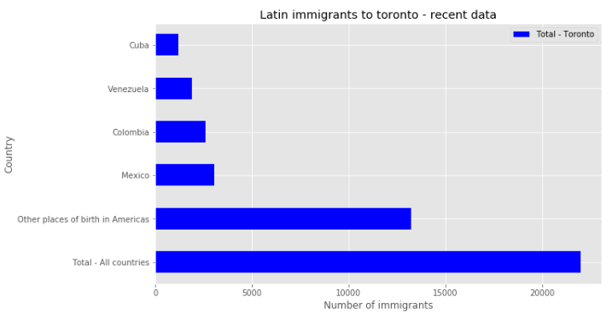
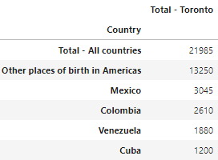
Toronto Recent inmigration
Removing countries from the Americas with diferente background - 'Brazil','Haiti', 'Jamaica', 'United States' / assuming that Other places of birth in Americas mostly are hispanic

Slide 7
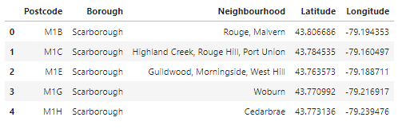
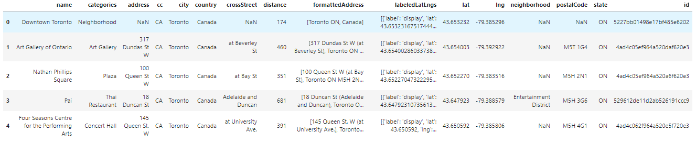
Toronto Geo Coordinates and Getting data from Foursquare

Slide 8
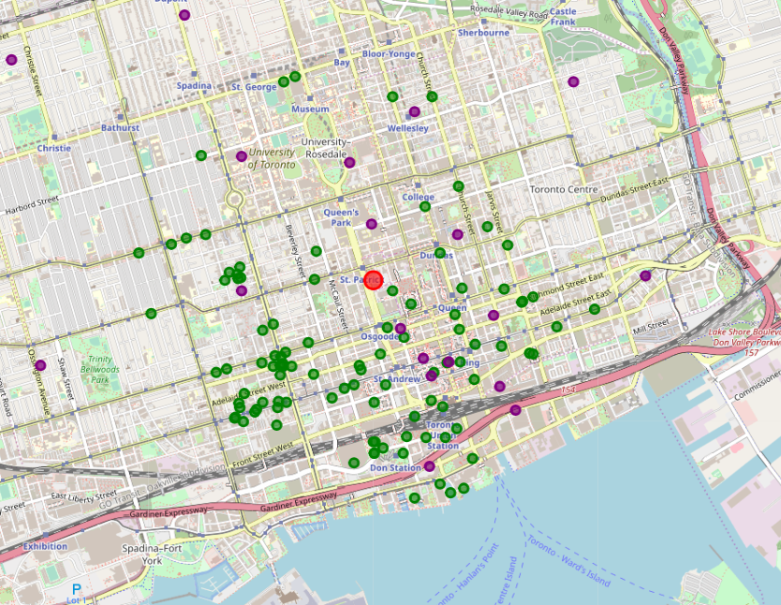
Printing information into folium.Map - Center downtown Toronto

Slide 9
Conclusion
We can indicate that Toronto has an interesting client base in the Hispanic community, all of the above, without counting the non-Hispanic population that lives in the city and that could potentially show interest in this type of cuisine.
As we can see on the map above, the best location for a new Venezuelan restaurant
Downtown Toronto
Chinatown, Grange Park, Kensington Market
St. James Town
Design Exchange, Toronto Dominion Centre
Commerce Court, Victoria Hotel
Harbourfront East, Toronto Islands, Union Station

Slide 10
Recommendation for a more detailed research
Retrieve more venues from Foursquare, at the time for this research, Foursquare limit the return for the request to 100 venues
Remove possible competition with other Latin places for possible reconsideration for final location
Considerer what type of food will be better received by the public (Fast Food or sit in)

